Slide 1
SQL PROJECT
Name : Saranya.S
Course : Master in Data science & Analytics with AI

Slide 2
Average Sales Data 07 to 23
ABC Ltd company produces the following
Urea
Neem based fertilizers
Agro chemicals
Bio-fertilizers
Organic manure
City-compost

Slide 3
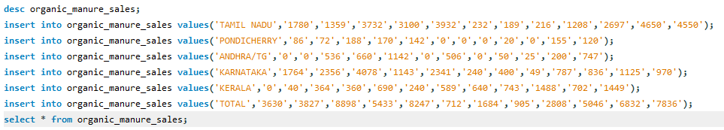
Implementation of DDL,DML
Creating tables
Inserting Values

Slide 4

Implementation of Constraints
Primary key
Foreign key

Slide 5


Implementation of Aggregate functions
Avg, Count, Max, Min, Sum

Slide 6
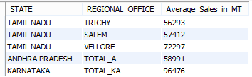
Implementation of Operators
Range Operator

Slide 7

Implementation of Operators
Relational Operator

Slide 8
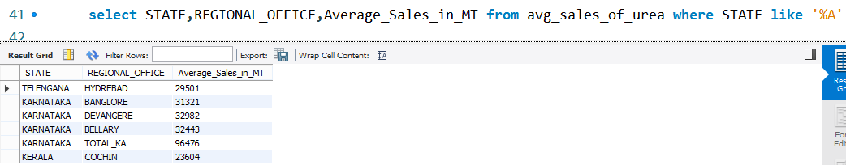
Implementation of Operators
Like Operator

Slide 9
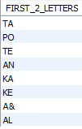
Implementation of function
String Function

Slide 10
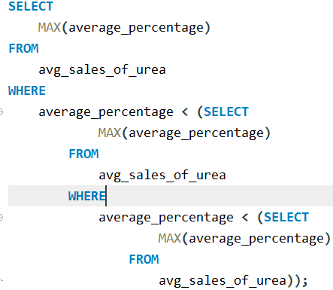
Implementation of Subquery
Inner query
Rules of Subquery

Slide 11
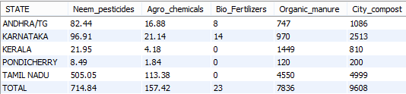
Implementation of Joins
State wise sales data of the current year (2022-2023) of the products

Slide 12
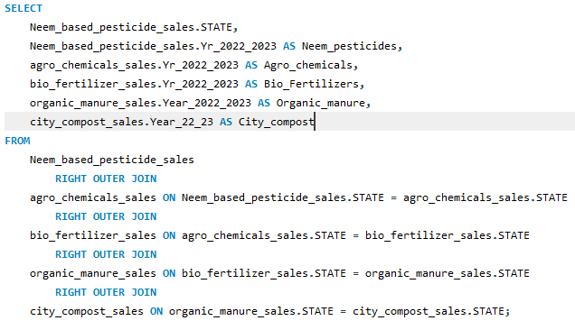
Right Outer Join

Slide 13
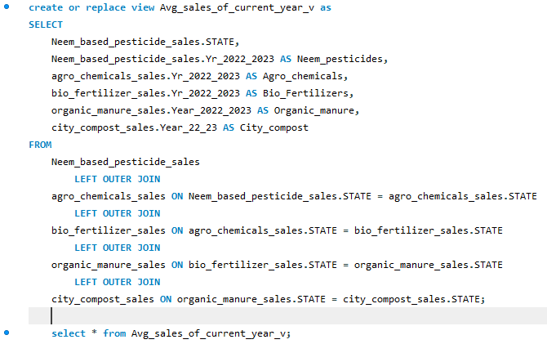
Implementation of View

Slide 14
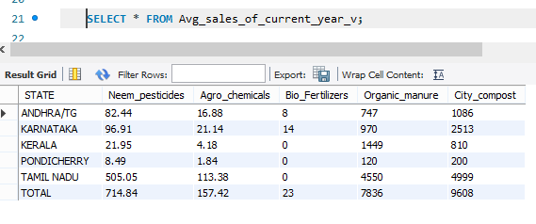
Output of View Command

Slide 15
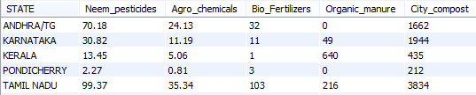
Pre Corona Sales
Sales Data for the year 2018-2019

Slide 16
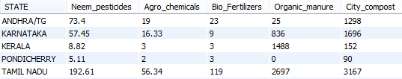
Sales during Corona
Sales Data for the year 2019-2020

Slide 17
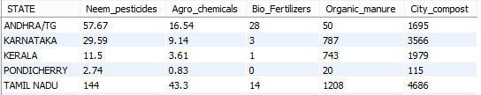
Post Corona Sales
Sales data for the year 2020-2021

Slide 18
CONCLUSION
Comparative Analysis of the sales data for the three consecutive years has been done.
It is concluded that there was a slight dip in sales during the corona period though it wasn’t affected much.

Slide 19


